Slide 1
CLAMShell: Speeding up Crowds for Low-Latency Data Labeling
Daniel Haas, Jiannan Wang,
Eugene Wu, Michael J. Franklin
VLDB 2016
New Delhi, India

Slide 2
Today’s systems need labeled data, fast.

Slide 3
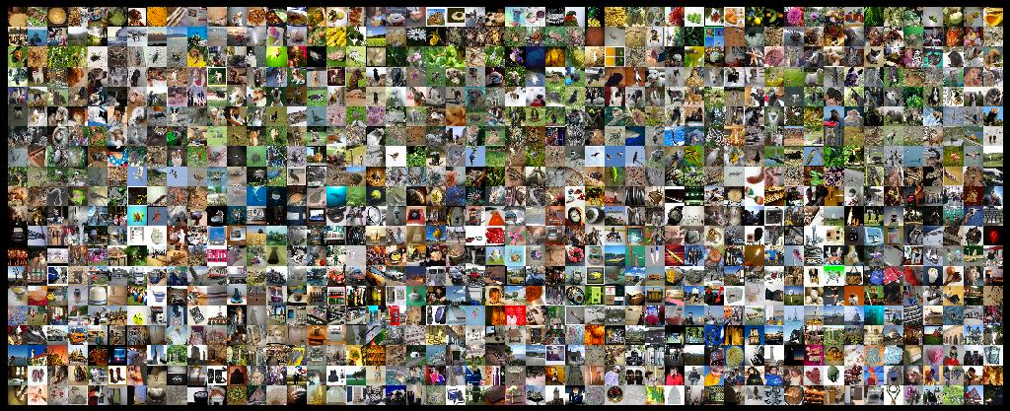


Supervised learning

Slide 4
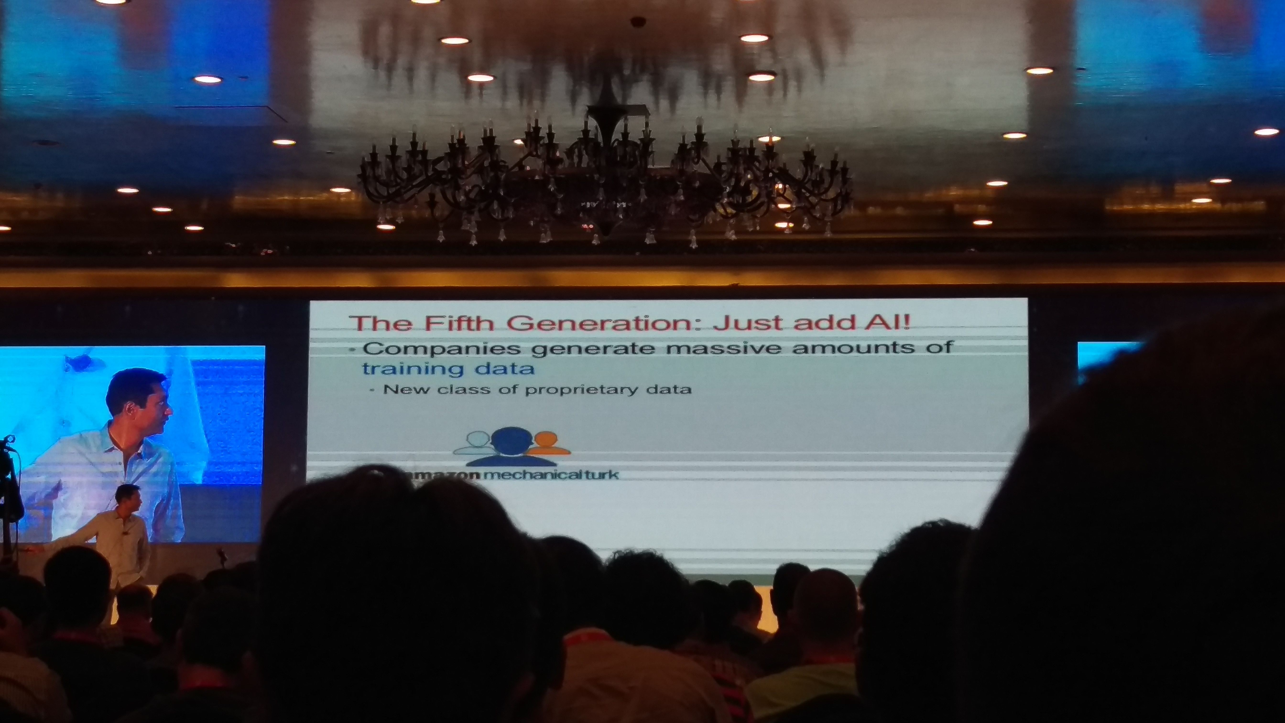
Supervised learning

Slide 5
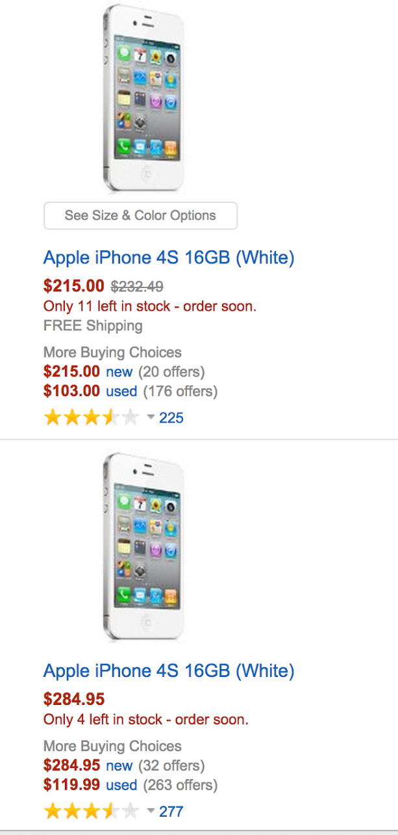
Data cleaning
=
?
iPhone 4s 16GB (White)
White iphone 4S 16
Entity Resolution

Slide 6
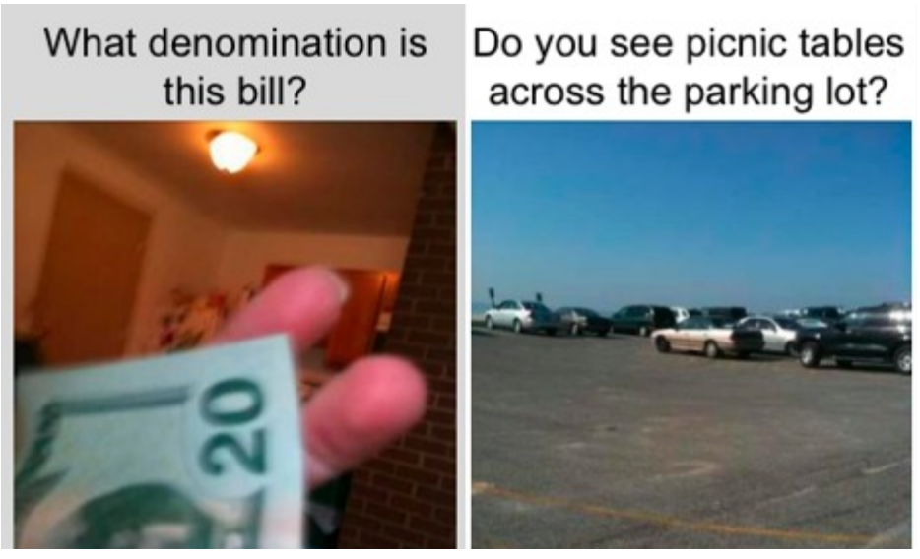
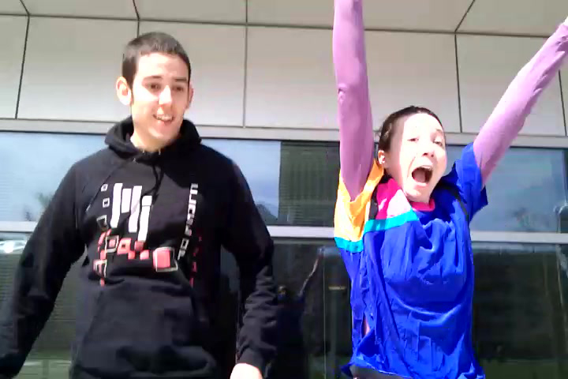
Real-time Applications
Answering visual questions for blind users
[Bigham et al. 2010]
Crowd-assisted photography
[Bernstein et al. 2011]
Notes:
Applications—supervised learning is one, there are others (show these)

Slide 7
Labeling is seldom automated
“[survey] participants reported hundreds of employees deploying hundreds of thousands of tasks per week, with overall spending in the millions of dollars per year.
”
A. Marcus and A. Parameswaran. Crowdsourced data management: industry and academic perspectives. Foundations and Trends in Databases, 2015.

Slide 8




Enter the microtask
In the literature:
CrowdDB, Deco, Qurk,
Corleone, CrowdER,
DataTamer, Usher, …
YES
NO

Slide 9
Problem: crowds are not fast
Completing individual microtasks should be quick.
Notes:
Propagate to other slides, maybe clean this up.

Slide 10
Problem: crowds are not fast
Completing individual microtasks should be quick.
But papers report latencies of minutes to hours per task, or use cost as a proxy for latency!
Notes:
Propagate to other slides, maybe clean this up.

Slide 11
Problem: crowds are not fast
Completing individual microtasks should be quick.
But papers report latencies of minutes to hours per task, or use cost as a proxy for latency!
This is too slow and too variable for interactivity.
Notes:
Propagate to other slides, maybe clean this up.

Slide 12
Our solution
An investigation of the sources of crowd latency
Our system, CLAMShell
Novel techniques for latency reduction
Declarative specification of labeling tasks
Available open source.
An evaluation of CLAMShell on >1,000 crowd
workers showing up to 8x end-to-end speedup

Slide 13
Our solution
An investigation of the sources of crowd latency
Our system, CLAMShell
Novel techniques for latency reduction
Declarative specification of labeling tasks
Available open source.
An evaluation of CLAMShell on >1,000 crowd
workers showing up to 8x end-to-end speedup

Slide 14
Where does the time go?
Labeling System
Learning
System
Dataset
Pool of Crowd Workers

Slide 15
Where does the time go?
Labeling System
Batch of
records
Learning
System
Dataset
Pool of Crowd Workers

Slide 16
Where does the time go?
Labeling System
Batch of
records
Labeling
tasks
Learning
System
Dataset
Pool of Crowd Workers

Slide 17
Where does the time go?
Labeling System
Batch of
records
Labeling
tasks
Learning
System
Dataset
Recruit Time
Pool of Crowd Workers

Slide 18
Where does the time go?
Labeling System
Batch of
records
Labeling
tasks
Learning
System
Dataset
Work Time
Recruit Time
Pool of Crowd Workers

Slide 19
Where does the time go?
Labeling System
Batch of
records
Labeling
tasks
Labels
Learning
System
Dataset
Work Time
Recruit Time
Pool of Crowd Workers

Slide 20
Where does the time go?
Batch Time
Labeling System
Batch of
records
Labeling
tasks
Labeled
records
Labels
Learning
System
Dataset
Work Time
Recruit Time
Pool of Crowd Workers

Slide 21
Where does the time go?
Batch Time
Labeling System
Batch of
records
Labeling
tasks
Labeled
records
Labels
Learning
System
Learning
Time
Dataset
Labeled Dataset
Work Time
Recruit Time
Pool of Crowd Workers

Slide 22
Our solution
An investigation of the sources of crowd latency
Our system, CLAMShell
Novel techniques for latency reduction
Declarative specification of labeling tasks
Available open source.
An evaluation of CLAMShell on >1,000 crowd
workers showing up to 8x end-to-end speedup

Slide 23

The CLAMShell
System
Task batch
Labeling
tasks
Task Selector
Uniform
Hybrid
Active
Batcher
Labels &
predictions
Model Trainer
User

Slide 24
The CLAMShell
System
Pool Manager
Scheduler
LifeGuard
Mitigator
Maintainer
Task batch
Labeling
tasks
Task Selector
Uniform
Hybrid
Active
Batcher
Labels &
predictions
Model Trainer
User

Slide 25
Retainer Pool Slots
S₁
S₂
S₃
✗
S₄
Crowd
Platform
T₀’
T₀
T₁
The CLAMShell
System
Mitigation
task
New task
Churn
Labels
Pool Manager
Scheduler
LifeGuard
Mitigator
Maintainer
Task batch
Labeling
tasks
Task Selector
Uniform
Hybrid
Active
Batcher
Labels &
predictions
Model Trainer
User

Slide 26
Implementation
AMPCrowd (https://amplab.github.io/ampcrowd)
Python/Django/PostgreSQL
Declarative API
Crowd platform-independent
Automated quality control
+ All the low-latency techniques in this talk

Slide 27
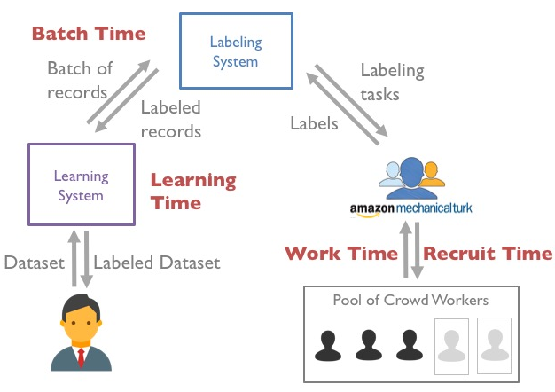
Attacking Latency
Work Time
Recruitment Time
Batch Time
Learning Time

Slide 28
Attacking Latency
Work Time
Task-dependent interface optimization
See [Marcus et al. 2011]
[Parameswaran et al. 2013]
[Krishna et al. 2016]
Recruitment Time
Batch Time
Learning Time

Slide 29
Attacking Latency
Work Time
Recruitment Time
Retainer Pools and other HCI fun
See [Bernstein et al. 2011]
[Bigham et al. 2013]
[Gao et al. 2014]
Batch Time
Learning Time

Slide 30
Attacking Latency
Work Time
Recruitment Time
Batch Time
Reduce tail latency with straggler mitigation
Reduce average latency with pool maintenance
Learning Time
Increase throughput with hybrid learning

Slide 31
Attacking Latency
Key insight:
a crowd is a distributed system!

Slide 32
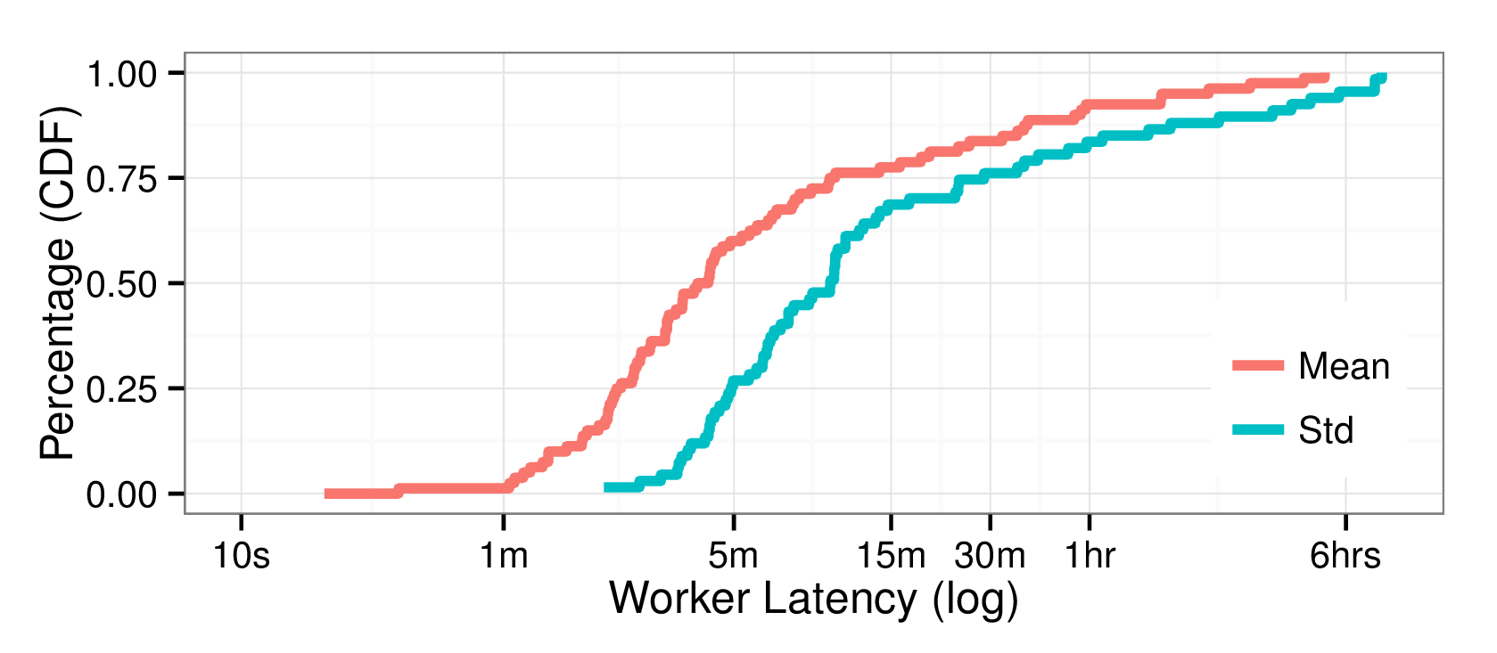
Reducing Batch Time

Slide 33
Reducing Batch Time: Tail Latency
Long tail

Slide 34


Reducing Batch Time: Tail Latency
Y
N
Y
N
Y
N
Notes:
Change all to reducing

Slide 35
Reducing Batch Time: Tail Latency
Straggler
mitigation
Y
N
[Dean et al. 2008]
[Zaharia et al. 2008]
[Ananthanarayanan et al. 2010]
Y
N
Y
N
Y
N
Notes:
Mention cost here on the next slide, we’ll cover it in eval. Maybe cover interesting details in a new slide—human details.

Slide 36
Reducing Batch Time: Tail Latency
Subtleties:
Interface. Make the experience less jarring for workers.
Cost. When to pay? What’s the overhead?
Notes:
Mention cost here on the next slide, we’ll cover it in eval. Maybe cover interesting details in a new slide—human details.

Slide 37
Reducing Batch Time: Avg. Latency
Slow average speed

Slide 38
Reducing Batch Time: Avg. Latency
Track worker speeds and release slow workers!
Current Crowd Worker Pool
Worker₁
Worker₂
Worker₃
Avg. Speed:
4 s / task
Avg. Speed:
6 s / task
Avg. Speed:
10 m / task
We call this “Pool Maintenance”

Slide 39
Reducing Batch Time: Avg. Latency
Track worker speeds and release slow workers!
Current Crowd Worker Pool
✗
Worker₁
Worker₂
Worker₃
Avg. Speed:
4 s / task
Avg. Speed:
6 s / task
Avg. Speed:
10 m / task
✗
= marked for release

Slide 40
Reducing Batch Time: Avg. Latency
Track worker speeds and release slow workers!
Current Crowd Worker Pool
Worker₁
Worker₂
Empty
Avg. Speed:
4 s / task
Avg. Speed:
6 s / task
Recruit asynchronously to reduce empty time

Slide 41
Reducing Batch Time: Avg. Latency
Track worker speeds and release slow workers!
Current Crowd Worker Pool
Worker₁
Worker₂
Worker₄
Avg. Speed:
4 s / task
Avg. Speed:
6 s / task
Avg. Speed:
???
Compute speeds with confidence intervals to avoid mistakes

Slide 42
Attacking Latency
Work Time
Recruitment Time
Batch Time
Reduce tail latency with straggler mitigation
Reduce average latency with pool maintenance
Learning Time
Increase throughput with hybrid learning

Slide 43
Reducing Learning Time
If you have TBs of data, humans can’t label everything
So show workers only a sample of the records
Then train a model to predict remaining labels!

Slide 44

Reducing Learning Time
Active Learning can reduce #points to label:
Accuracy Threshold
Request batch of labels
Active Learner
Labeling System
Update model
Trained model
Return batch
[Cohn et al. 1996] [Gokhale et al. 2014] [Mozafari et al. 2014]

Slide 45
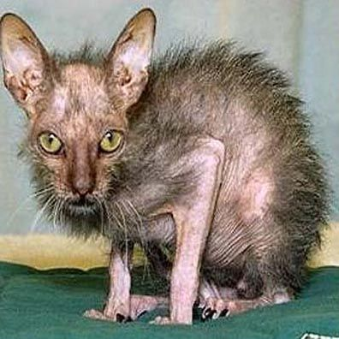
Reducing Learning Time
Active Learning can reduce #points to label:
“Uncertainty Sampling”
>

Slide 46
Reducing Learning Time
Active Learning can reduce #points to label:
“Uncertainty Sampling”
>
Practical limitations:
Batches must be small
Sometimes gets stuck

Slide 47
Reducing Learning Time
Maximize pool parallelism by running active and passive learning in parallel
Retainer Pool Slots
Hybrid Learning:
Active batch size = 1
Worker₁
Worker₂
Worker₃
Task₁
Task₂
Task₃
Model ensembling to combine active and passive learners
Task Selector
Active
Uniform

Slide 48
Our solution
An investigation of the sources of crowd latency
Our system, CLAMShell
Novel techniques for latency reduction
Declarative specification of labeling tasks
Available open source.
An evaluation of CLAMShell on >1,000 crowd
workers showing up to 8x end-to-end speedup

Slide 49
Evaluating CLAMShell
Over 1,000 workers on MTurk, ~250,000 tasks, $15-20k
Datasets: CIFAR, MNIST
Paid workers $.02 / task, $.05 / minute

Slide 50
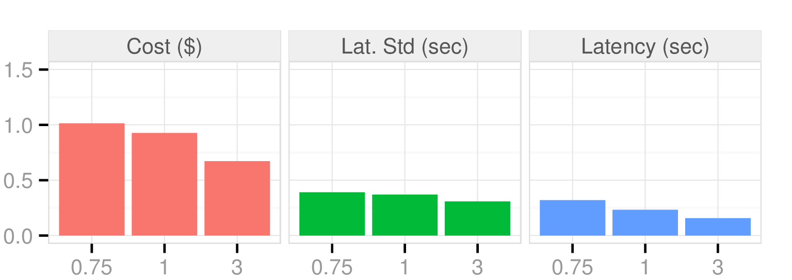
Effects of Straggler Mitigation
SM / No SM Ratio
Ratio of Pool Size to Batch Size
Up to 5x speed-up, 10x variance reduction
over base retainer pool implementation
with under 2x cost increase

Slide 51
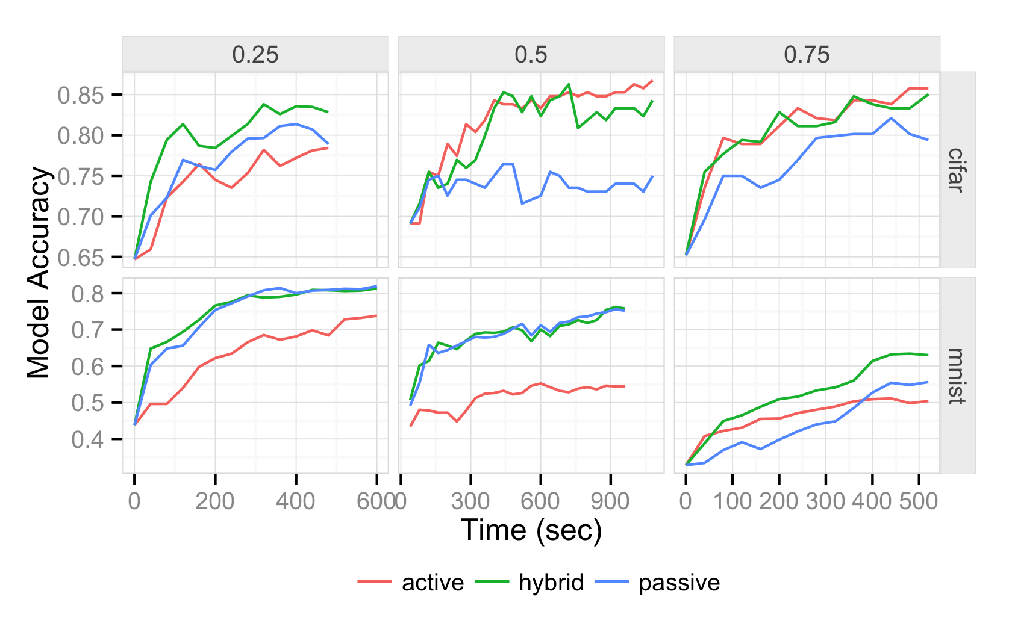
Effects of Hybrid Learning
Fraction of pool used for Active Learning
600 0

Slide 52
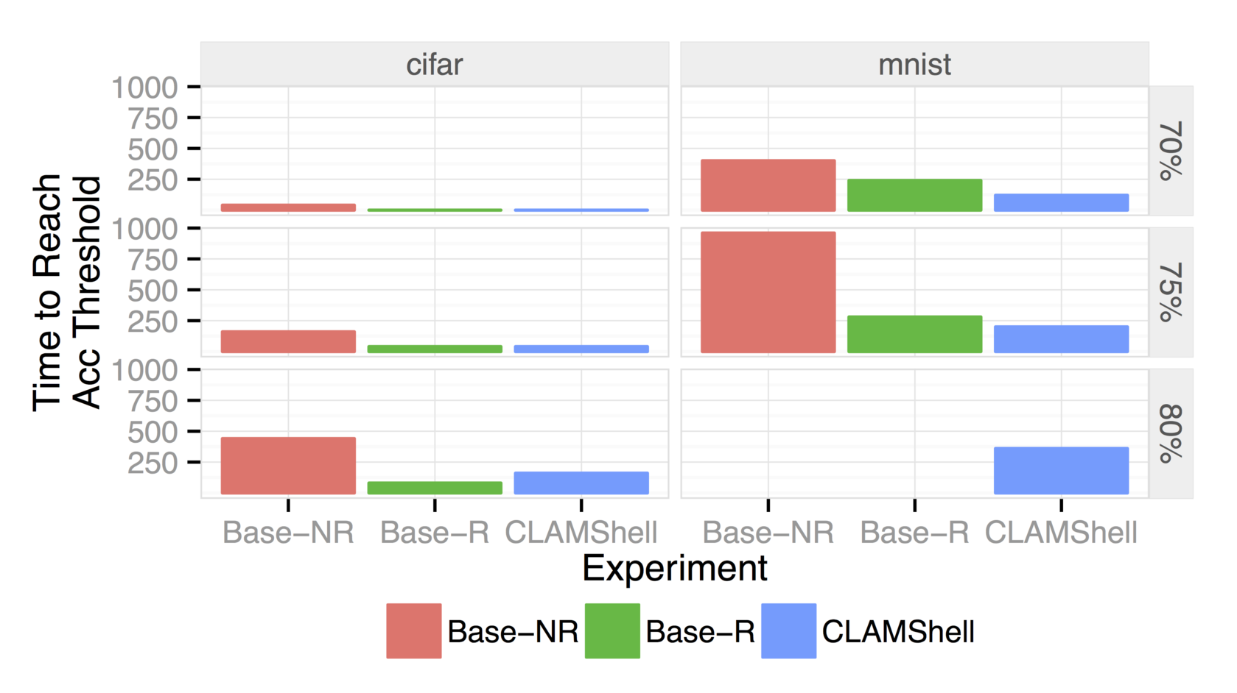
End-to-end Performance
Time to reach
threshold (sec)
Accuracy Threshold
✗
✗
Up to 8x speed-up, 151x variance reduction over Base-NR.
Notes:
Build in—show 70%, 75%, 80%

Slide 53
CLAMShell: Summary
Batch Time
Labeling System
Batch of
records
Labeling
tasks
Labeled
records
Labels
Learning
System
Learning
Time
Dataset
Labeled Dataset
Work Time
Recruit Time
Pool of Crowd Workers

Slide 54
Thanks!
CLAMShell
Understand crowd latency
8x speedup and 150x variance reduction
Available open source!
dhaas@cs.berkeley.edu
amplab.github.io/ampcrowd

Slide 56
Backup Slides

Slide 57
Latency and quality control
Y
N
Techniques are complimentary, but can get expensive!
Y
N
Y
N
Y
N
Y
N

Slide 58
Why not just deep learn everything?
Isn’t it just a matter of time until humans are replaced?
The frontier keeps moving.
Humans and machines can work together.
Notes:
----- Meeting Notes (4/5/16 14:30) -----
show the value of the system that no one has done before: good for increasing impact--solve the imagination gap.
disaster response coordination, realtime DARPA-like mobile data applications, robotics learning from demonstration, do more than just label cats
time-varying trends: capitalizing on this

Slide 59
Motivation from Data Cleaning
1.
webpages
Count(*)
Sample
Rule: Extract address
[VLDB Demo 2015]

Slide 60
Motivation from Data Cleaning
1.
webpages
Count(*)
Sample
Rule: Extract address
2.
webpages
Rule: Extract address
[VLDB Demo 2015]

Slide 61
Motivation from Data Cleaning
1.
webpages
Count(*)
Sample
Rule: Extract address
2.
webpages
Rule: Extract address
3.
webpages
Crowd: Extract address
[VLDB Demo 2015]

Slide 62
Motivation from Data Cleaning
1.
webpages
Count(*)
Sample
Rule: Extract address
2.
webpages
Rule: Extract address
3.
webpages
Crowd: Extract address
4.
webpages
Rule: Extract address
Crowd + Active Learning:
Extract address
[VLDB Demo 2015]

Slide 63




Data analysis is getting faster

Slide 64
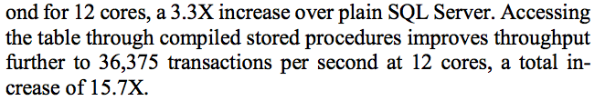

Slide 65
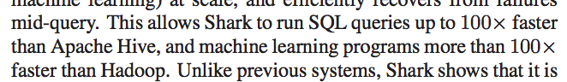

Slide 66
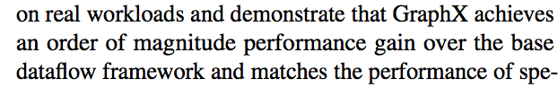

Slide 67
But humans process a lot of data
=
?
iPhone 4s 16GB (White)
White iphone 4S 16

Slide 68
But humans process a lot of data
YES
NO
Is there a cat in this photo?

Slide 69

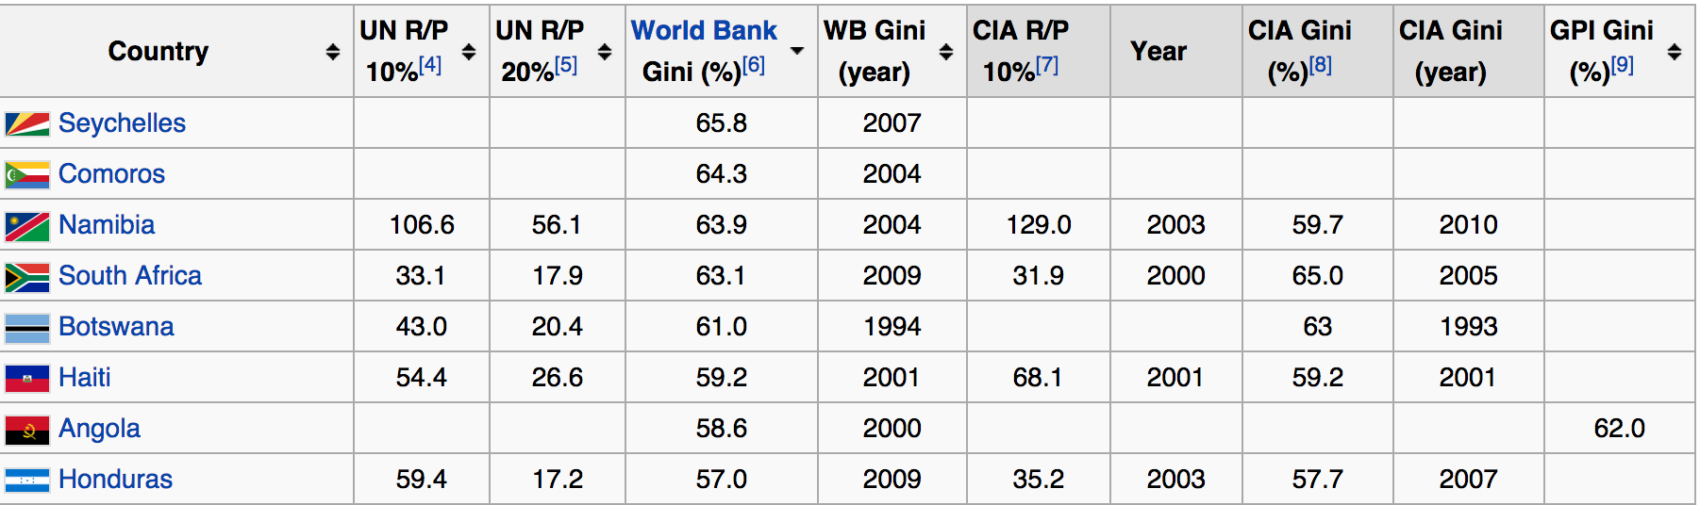
But humans process a lot of data

Slide 70
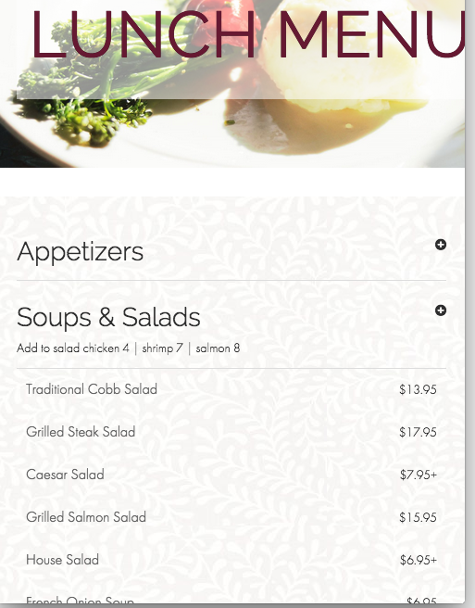
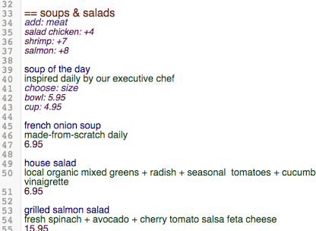
But humans process a lot of data

Slide 71
Crowdsourced data analysis

Slide 72
Crowdsourced data analysis
Microtasks
YES
NO

Slide 73
Labeling: a general abstraction
=
?
iPhone 4s 16GB (White)
White iphone 4S 16
Entity Resolution

Slide 74
Labeling: a general abstraction
YES
NO
Object Detection

Slide 75
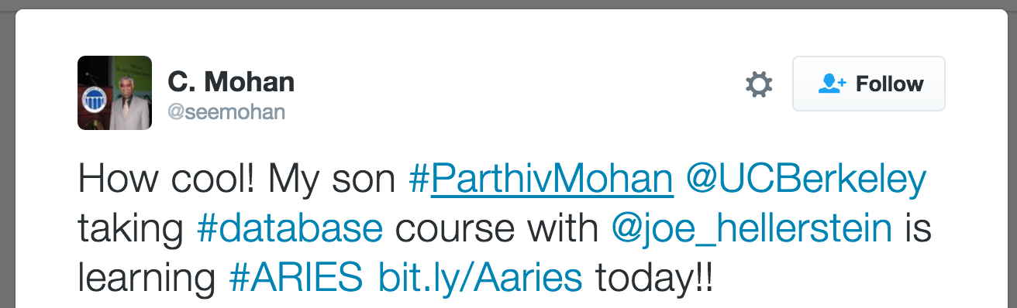
Labeling: a general abstraction
Positive
Neutral
Negative
Sentiment Analysis

Slide 76

Why is labeling slow?
Request batch of labels
Labeling System
Return batch
Return labels
Request labels
Recruitment Time
Recruit workers
Work Time
Perform work

Slide 77
Why is labeling slow?
Request batch of labels
Labeling System
Return batch
Batch Time
Return labels
Request labels
Recruitment Time
Recruit workers
Work Time
Perform work

Slide 78
Mitigating Work Time
Optimize the interface!
Out of scope for today, but see:
[Marcus et al. 2011]
[Parameswaran et al. 2013]
[Krishna et al. 2016]
…
Notes:
Throw CrowdER on there.

Slide 79
Mitigating Recruitment Time
“Pre-recruit” people and pay them to wait around!
Retainer Pool Slots
Task₀
Worker₁
Worker₂
Worker₃
Waiting…
Task₁
Task₂
[Bernstein et al. 2011] [Bigham et al. 2013] [Gao et al. 2014]

Slide 80
Where does the time go?
Request labels

Slide 81
Where does the time go?
Request labels
Recruit workers

Slide 82
Where does the time go?
Request labels
Recruit workers
Perform work

Slide 83
Where does the time go?
Return labels
Request labels
Recruit workers
Perform work

Slide 84
Where does the time go?
Return labels
Request labels
Recruitment Time
Recruit workers
Perform work

Slide 85
Where does the time go?
Return labels
Request labels
Recruitment Time
Recruit workers
Work Time
Perform work

Slide 86
Where does the time go?
Model Trainer
Labeling System
Request batch of labels
Return batch
Send dataset
Return labels
Request labels
Recruitment Time
Return model
Recruit workers
Work Time
Perform work

Slide 87
Where does the time go?
Model Trainer
Labeling System
Request batch of labels
Return batch
Batch Time
Send dataset
Return labels
Request labels
Recruitment Time
Return model
Recruit workers
Work Time
Perform work

Slide 88
Where does the time go?
Model Trainer
Labeling System
Request batch of labels
Return batch
Batch Time
Send dataset
Return labels
Request labels
Recruitment Time
Return model
Recruit workers
Learning
Time
Work Time
Perform work

